Slide 1


Slide 2
KNN algorithm (K NEAREST NEIGHBORS)
Simple, yet powerful!
Only one parameter: k (a small integer)
To make a prediction for a new object, find k closest examples in training set
For classification problems, output the majority class
For regression problems, output the mean of the target property

Slide 3
Let’s assume that we have coordinates x and y as features, and we want to predict the color. how would that work?
odd is better!

Slide 4
Let’s assume that we have coordinates x and y as features, what value should we use for k?
k = 2
k = 5
odd is better!

Slide 5
Tweakables!
1) Choose neighborhood radius instead of k
2) Weigh different objects according to distance (inverse-distance weighing)
Any insights on the effects of 1) and 2)?

Slide 6
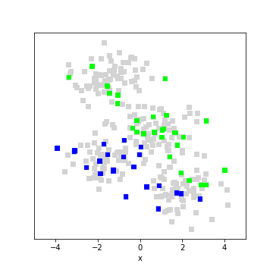
Tweakables!
1) Choose neighborhood radius instead of k
2) Weigh different objects according to distance (inverse-distance weighing)
Any insights on the effects of 1) and 2)?
If the data have non-uniform density, different choices will have different effects! Needs to be chosen via cross-validation (next unit).

Slide 7
we can now see how this works in code. Be ready for a surprise!

Slide 8
DT vs KNN recap
So far, we have looked at Decision Trees
and k Nearest Neighbors algorithm.
Let’s think about strengths and weaknesses.
Weaknesses:
Both: they work well only if they have seen similar examples.
Poor extrapolation properties, tend to “squeeze” distributions
kNN: needs scaling, otherwise one component may be dominant.
DT: can only split along features, feature engineering quite important.
Strengths:
DT: Interpretable, kNN: fast
Both: accurate if there is a well sampled learning set

